Slide 1
SoManyDisplays
Adaptive Decomposition and Composition of Interface
Seonwook Park
Roman Rädle
Hana Vrzáková
Hui-Shyong Yeo

Slide 2
Cross-device design sucks!

Slide 3
DUI - distributed user interface
Mark Weiser (1991)
DUI allows computer interfaces to be distributed across multiple devices, multiple users, and multiple platforms; in the same space or in the different geographical spaces; and at the same time or at different points in the time.
Notes:
M. Weiser. The computer for the twenty-first century. Scientific American, 3(265):94–104, Sept. 1991.
Elmqvist, Niklas. "Distributed user interfaces: State of the art." Distributed User Interfaces. Springer London, 2011. 1-12.

Slide 4
UI decomposition - Youtube segmentation
Title
Video
Play
Next
Comment

Slide 5
SoManyDisplays
TV, smartphone, tablet, smartwatch, projector, VR/AR head-mounted display…

Slide 6
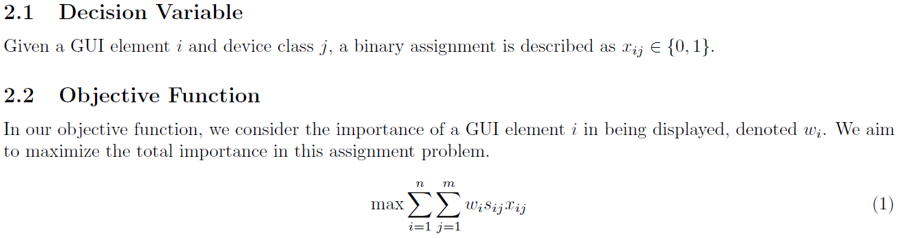
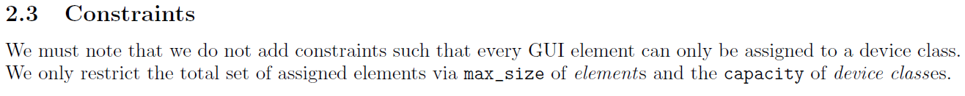
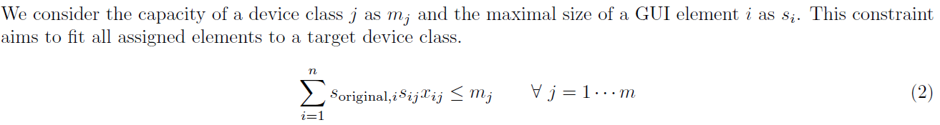
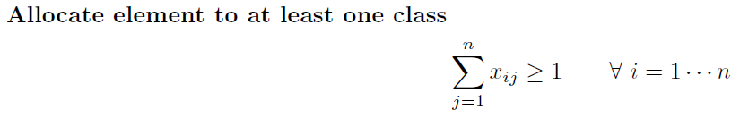
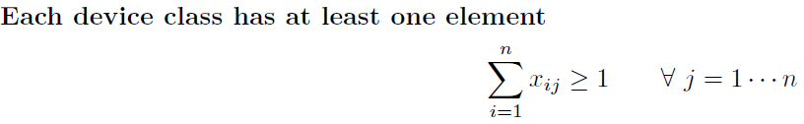
Notes:
Our first problem concerns the assignment of n GUI elements to m device classes. A GUI element can be assigned to multiple device classes. So we assume no restrictions on n and m.
Our second problem concerns the assignment of selected GUI elements to positions in a 1-dimensional layout of
each device class.

Slide 7
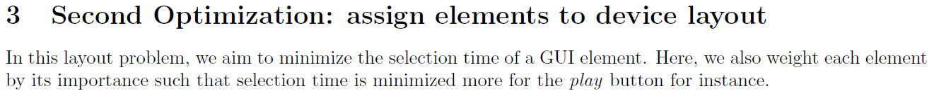
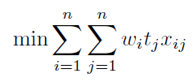

Slide 8
Implementation
Works over HTML, using JavaScript
Optimized in Gurobi Python
Communicate over websocket

Slide 9
Demo Time

Slide 10

Case example: YouTubers at party
Notes:
multi-user x multi-device

Slide 11
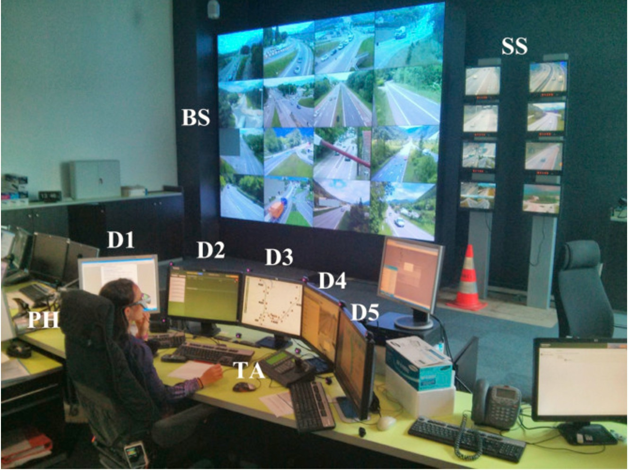
Case example: Traffic control room (Starke,2017)
Notes:
single-user x multi-device

Slide 12

Thank you

Slide 13
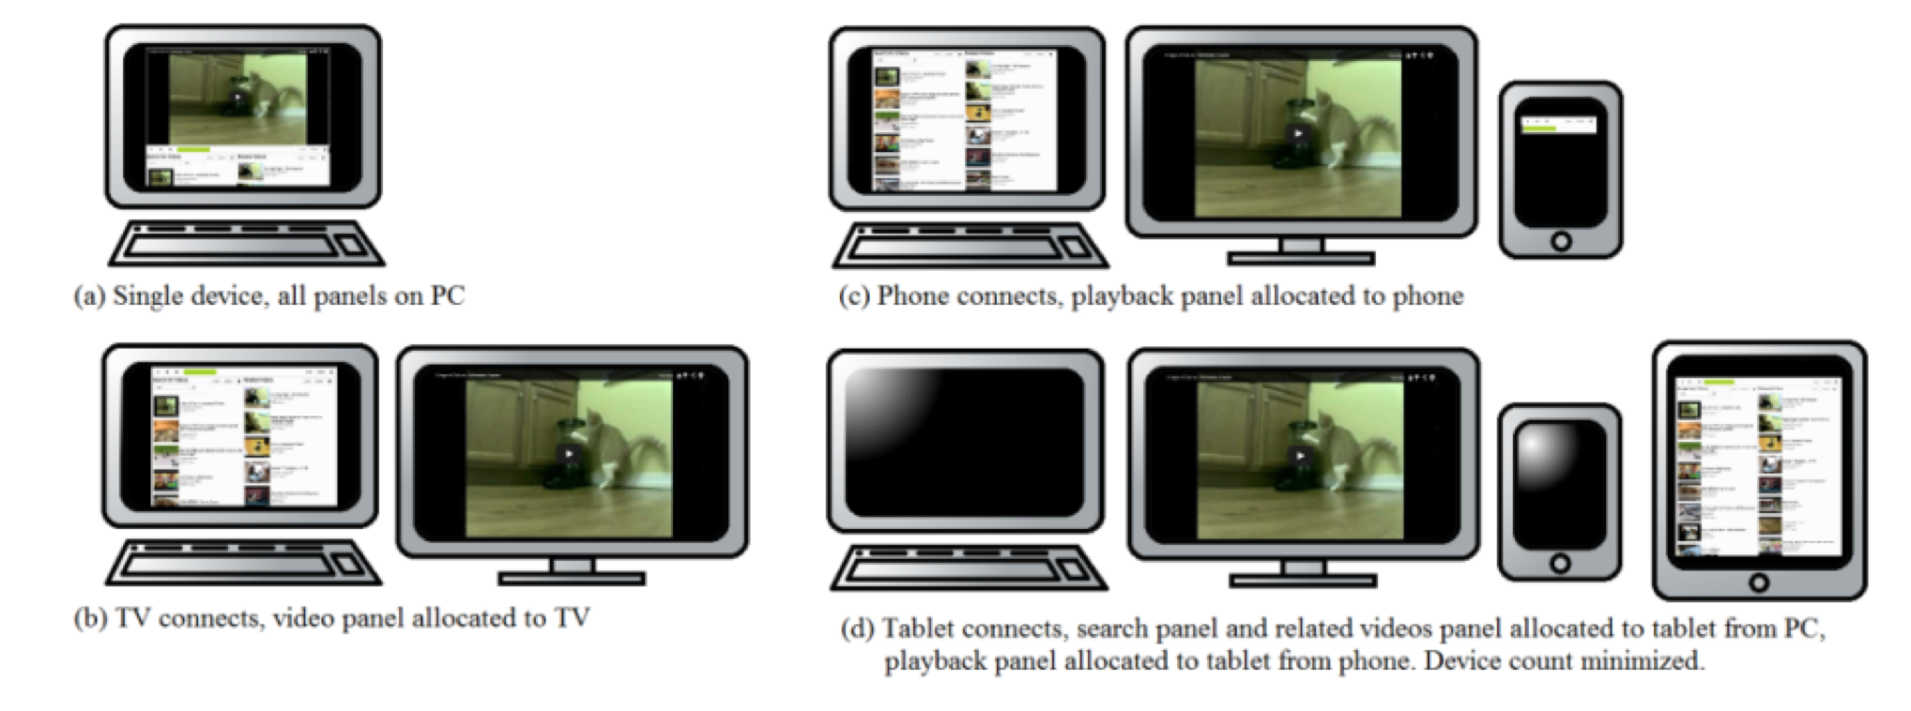
Panelrama (Yang,Wigdor,CHI’14)

Slide 14
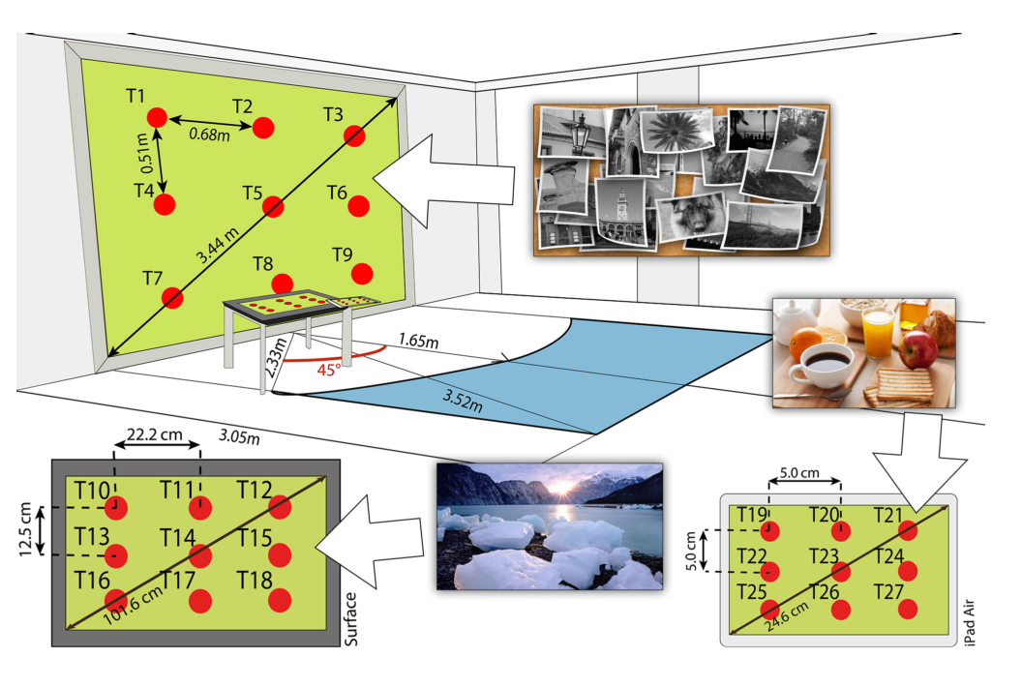
GazeProjector (Bulling et al. UIST’15)

Slide 15
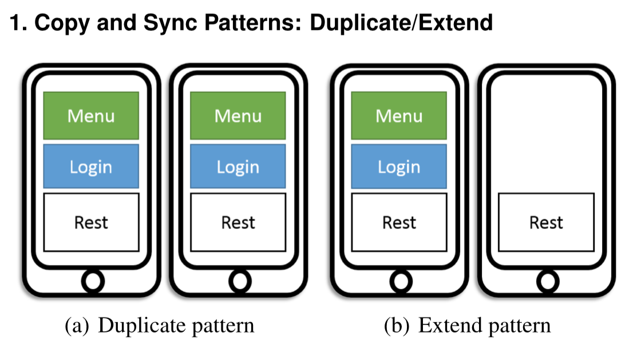
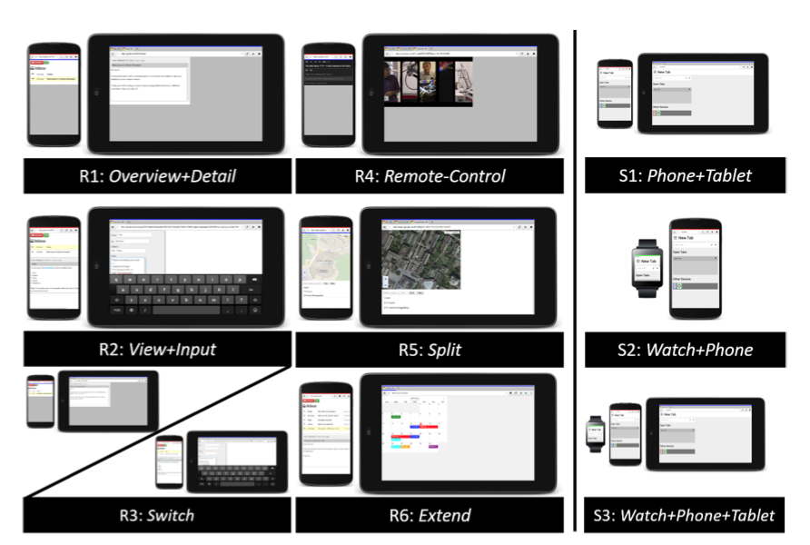
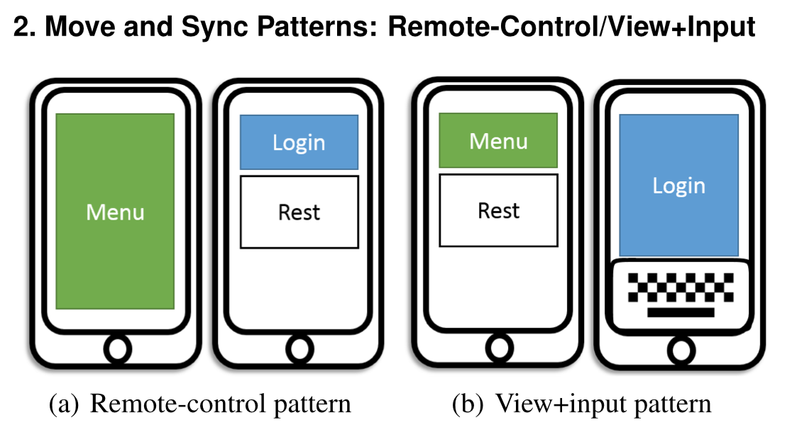
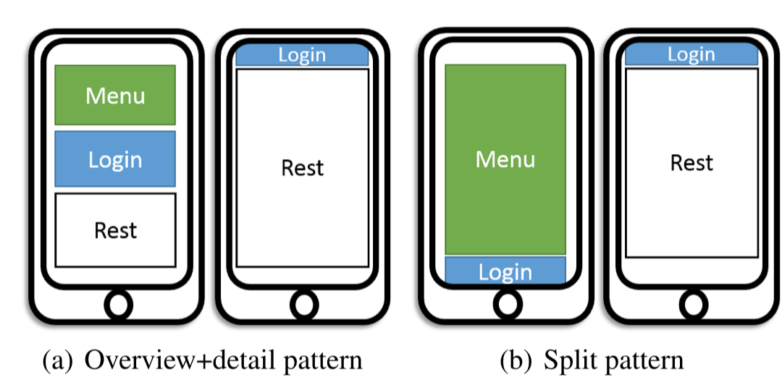
XDBrowser 2 (Nebeling, CHI’17)
Notes:
- R1-6 show the cross-device interface referents
- S1-3 the multi-device settings that formed the 18 elicitation tasks in the study.

Slide 16
Related Work
PanelRama (CHI’14) | XDBrowser (CHI’17)
Hand coded device properties | Hand coded
Based on developer’s perspective | Based on user’s gathered design patterns
For single-user control
1:1 device-panel mapping
semi-automatic generation of UI | semi-automatic generation of UI
E.g. Youtube, Streetview

